Slide 1






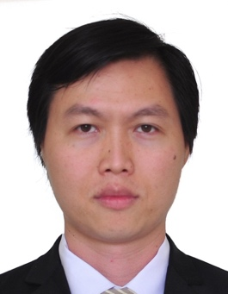
Benchmarking a Quantum Random Number Generator with Machine Learning
Jing Yan
Nhan
Jing Yan Haw^{1,3*},Nhan Duy Truong^{2^}, Syed M. Assad¹, Ping Koy Lam¹, Omid Kavehei²
¹CQC2T, Australian National University ²NeuroSyd Research Laboratory, School of Biomedical Engineering, University of Sydney ³QCL, ECE, National University of Singapore
* elehjy@nus.edu.sg ^ duy.truong@sydney.edu.au
Notes:
Hello everyone. My name is Jing Yan, from Quantum Communication Lab, National University of Singapore. It is my privilege to share with you our recent work, “Benchmarking a Quantum Random Number Generator with Machine Learning”, This work is done with my ANU colleagues Assad and Ping Koy, and ML experts from Uni of Sydney, Nhan and Omid.

Slide 2
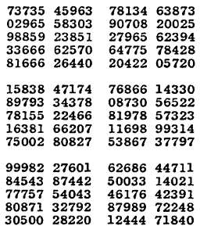
Random Numbers
Simulation (Monte Carlo, Sampling)
Cryptography
(Banking, Encryption, QKD)
Fundamental science (Loophole-free Bell test)
RAND Corporation - RAND's A Million Random Digits with 100,000 Normal Deviates.
[1] M. Herrero-Collantes and J. C. Garcia-Escartin, Rev. Mod. Phys. 89, 015004 (2017).
Notes:
Let us start by asking the question of: Why do we need random numbers? Firstly, in simulations, scientists use RN to solve complex problems by averaging over random instances, and to perform random sampling for statistics. For cryptographic applications, RN are required to ensure that security keys are drawn randomly for critical applications, such as banking, encryption and of course in protocols such as quantum key distribution. Finally, for fundamental science, experiments such as loophole free Bell-test would require randomness that is uncorrelated to the setup.

Slide 3


Random Number Generators
1. Pseudo RNGs
Algorithm + seed
- Linear congruential PRNGs
- Cryptographically secure PRNGs
2. True RNGs
Physical processes
- Chaotic RNG
- Quantum RNG
Cryptography
Uniform?
Private?
[1] M. Herrero-Collantes and J. C. Garcia-Escartin, Rev. Mod. Phys. 89, 015004 (2017).
Notes:
To generate random numbers, people usually relied upon either of these two options (a Pseudo RNG or a true RNG):
A PseudoRNG is typically based on seeded algorithm. Examples includes Linear congruential PRNG, which is based on recursive formula or a cryptographically secure PRNGs, which is usually designed to be computationally hard to find out past or future sequence given the current state of the generator. They could also be seeded by a TRNG.
And the second one being hardware, or sometime called true, RNG, where instead of mathematical complexity, it is based on physical processes., such as chaotic process and quantum phenomena.
When it comes to designing the RNGs for cryptographic applications, one would ask the following questions:
First, is the RNG output *uniformly* distributed and unbiased, secondly, is it private or secret, in other words, uncorrelated to any other parties?
Hardware RNG generally can satisty, however, the chaotic case is due lack of incomplete knowledge of the physical setup. We will come to the quantum one in more details later. For the PRNG, while it does provide high-quality uniform output, it is deterministic since once the seed is compromised, the protocol is no longer fully secure.

Slide 4
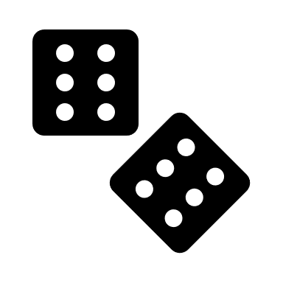

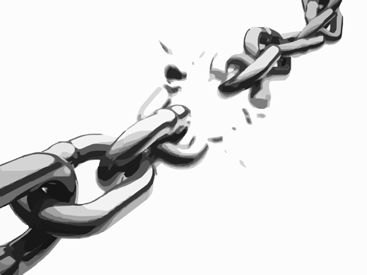
Vulnerability of RNGs
In 2012, the biggest scan of Transport Layer Security (TLS) and Secure Shell (SSH) over the internet unveiled surprisingly widespread vulnerable keys.
Heninger et al. ^{[1]} computed private keys for 0.5% of HTTPS hosts and 1.06% of the SSH hosts by exploiting known weaknesses of RSA and DSA when used with insufficient randomness
Weak Random Number Generator
Bad Cryptography
Cryptography is only as strong as its weakest link!
[1] Heninger et al. Proceedings of the 21st USENIX conference on Security symposium. 2012.
Notes:
Consider a case in 2012, where the biggest scan of the TLS and SSH has uncovered a widespread of vulnerable keys.
In particular, by exploiting the entropy loopholes, for example initialization with default setting or with poor entropy sources, Heninger and co-worker successfully cracked non-negligible amount of the private keys. Note an RSA encryption, which is based on factorization, is supposed to be computationally hard.
The lessons that we can learn here is that if you have a weak RNG for your crypto system, you are essentially leaving a backdoor to your supposedly secure system.
It does not really matter how secure or rigorous the other components are, as cryptography is only as secure as its weakest link.
Therefore, for cryptographic purposes and applications, one must design, or choose their RNG very carefully, and of course to test it RNG rigorously.

Slide 5
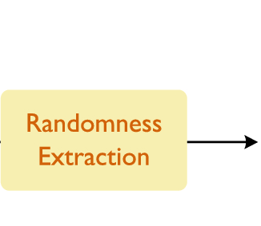
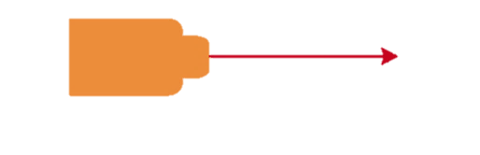
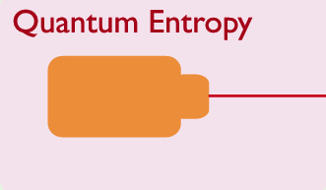
Quantum RNGs
In theory, QRNGs are ideal
→ Intrinsic randomness
→ Unpredictable and private
→ (almost)-uniform after post-processing
[1] M. Herrero-Collantes and J. C. Garcia-Escartin, Rev. Mod. Phys. 89, 015004 (2017).
Notes:
In view of such a security dilemma, QRNG, which is based on quantum effect, in theory, is the perfect solution.
First, a quantum phenomena is inherently random, and with access to a pure quantum state, one can guarantee the randomness to be unpredictable and private. We note that is also device-independent scenario, where one instead generate randomness from non-local correlations without assuming knowledge of the system.
While the output might be biased, one can distill the randomness via an extractor to obtain a close to uniform output

Slide 6
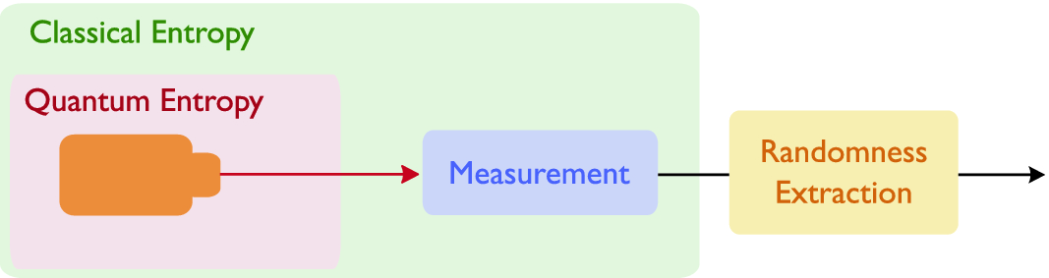
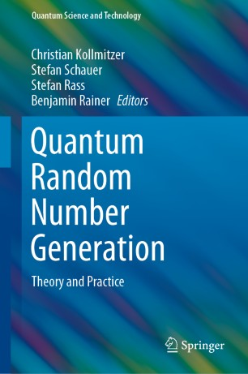
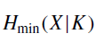
Practical QRNGs
Side-information
- Sources could be in a mixed state
- Measurement devices & environment introduce noises
- Proper modelling and characterisation to quantify the min-entropy conditioned on the side-information K (for device-dependent and semi-device-independent RNGs)
Haw et al. "Secure Random Number Generation in Continuous Variable Systems." Quantum Random Number Generation. Springer, Cham, 2020. 85-112.
Notes:
This is all good, however, in reality, the state might not be pure, and neither do we have a noiseless measurement device, nor a QRNG that is isolated from the environment. As such, the additional entropy from undesired sources, both quantum and classical will need to be characterise and model the QRNG to ensure that only the trusted and desired quantum entropy are extracted. the device-dependent and sdi RNGs

Slide 7
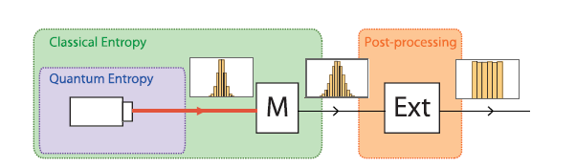

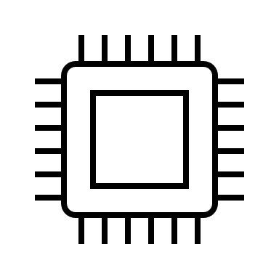
What can go wrong with a (Q)RNG?
Big Data, Machine Learning…
Randomness (Security) compromised!
Deviation from modelling (unaccounted noise, residual correlations, invalid assumptions…)
Defective parts
Poor choice of extractors

Slide 8
Health check & testing?
Statistical Testing (NIST, DieHarder, TestU01…)
- Health Checking - Entropy Estimation
Based on statistical estimators and predictors
Prone to unknown statistical behaviours & long-range correlations
“No set of general-purpose statistical tests can measure the entropy per sample in an arbitrary sequence of values” ^{[1]} – John Kelsey, NIST SP 800-90 Manager
[1] https://csrc.nist.gov/csrc/media/events/random-bit-generation-workshop-2016/documents/presentations/session-i-1-john-kelsey-presentation.pdf

Slide 9
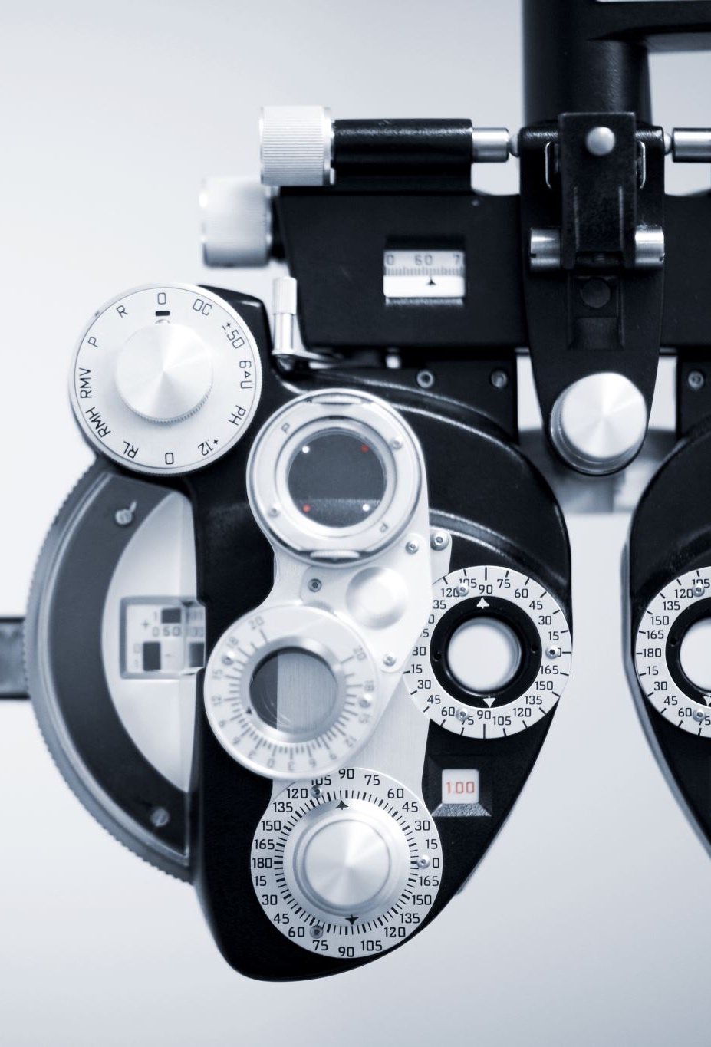
Turn the adversarial tools into diagnostic tool
Question: Can we examine the underlying randomness without
Knowing the internal working principle?
Relying on statistical algorithm?
Machine Learning Cryptanalysis

Slide 10
Content Outline
Introduction
QRNG under test (QUT)
ML tools
Method
Dataset
Training of ML
Results
Non-uniform randomness
Uniform randomness
Notes:
Here’s a brief outline for the content today. First, I will introduce to you our QRNG under test, and Nhan will be your tour guide for the machine learning, in particular, how we deal with the data and train our machine. Finally, I will present to you our results, where we evaluate the performance of our model by examining two scenarios: raw data with partial randomness and postprocessed data that is almost uniformly distributed

Slide 11
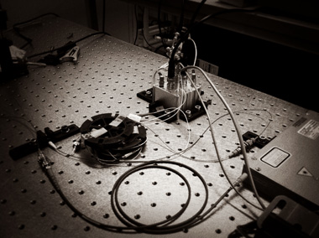
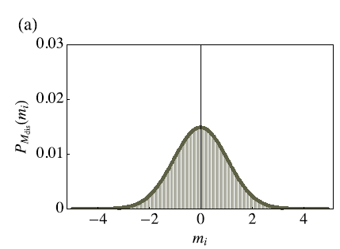
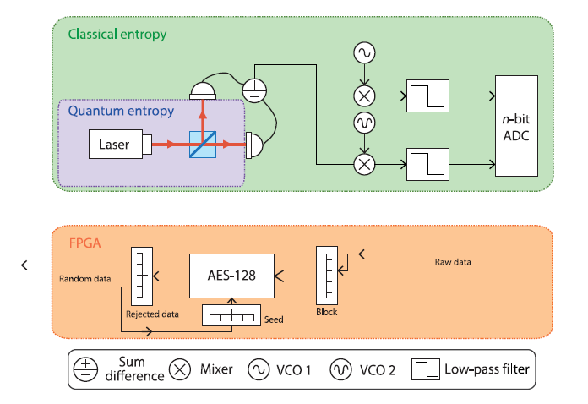
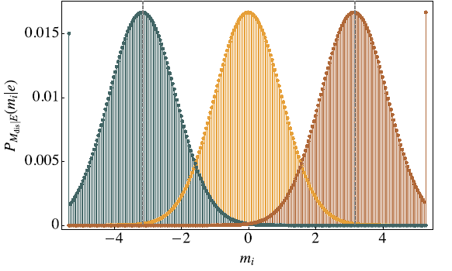
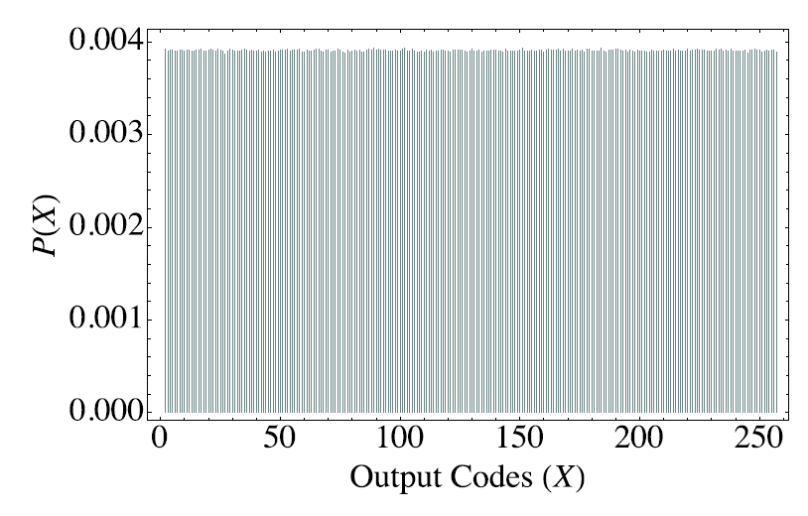
QRNG under test (QUT)
Continuous variable QRNG^{[1]}
Homodyne measurement of vacuum state
ADC dynamical range optimized for maximum secure entropy
Secure against classical side-information
Real-time secure bits generation rate of >3.5Gbps
[1] Jing Yan Haw. et al. Maximization of Extractable Randomness in a Quantum Random-Number Generator. Phys. Rev. Applied 3, 054004 (2015).
Notes:
Our QRNG under test is a continuous variable QRNG, where the entropy source comes from the vacuum fluctuation. This entropy is harnessed via the broadband homodyne measurement, in which the amplitude-quadrature of the vacuum state, which is Gaussian distributed, is amplified by the local oscillator. In our work, we quantified the classical side-information in our entropy estimation and optimised our analog-to-digital converter for maximum throughput. Finally, we post-processed our output with cryptography hashing function (Advance Encryption Standard) and obtained a final secure bit-generation rate of more than 3.5 Gbit/s.

Slide 12
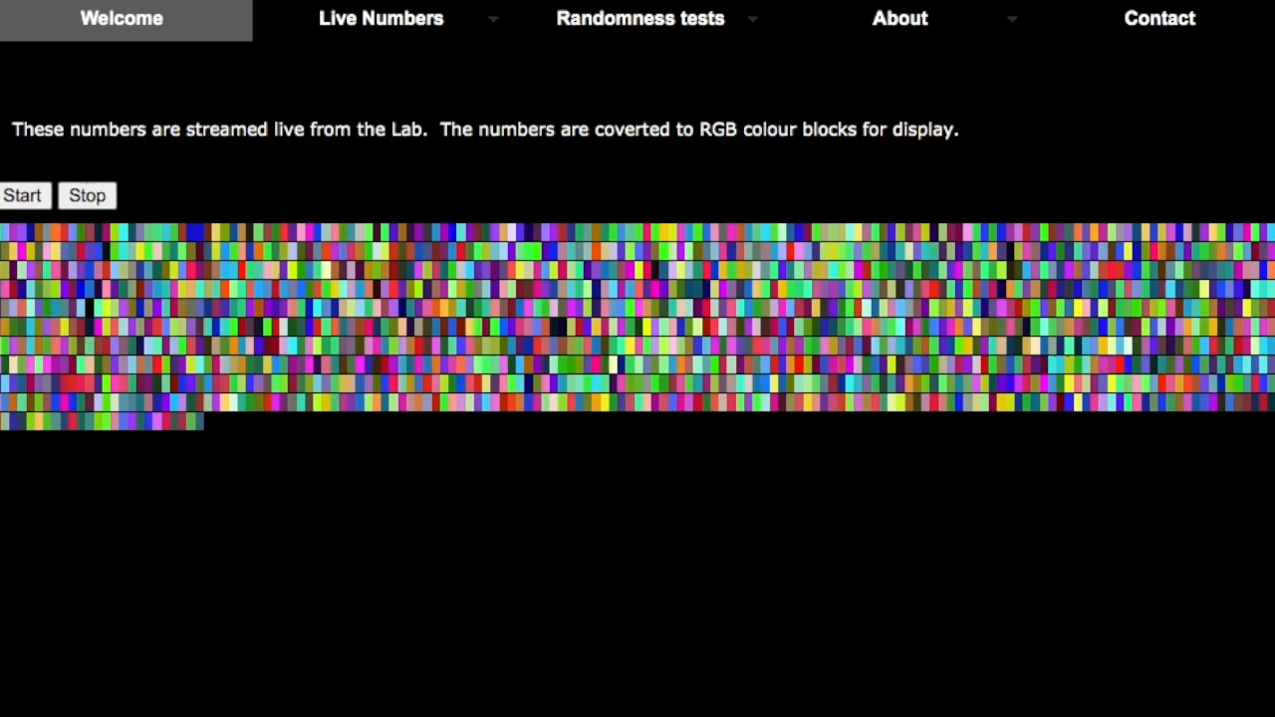
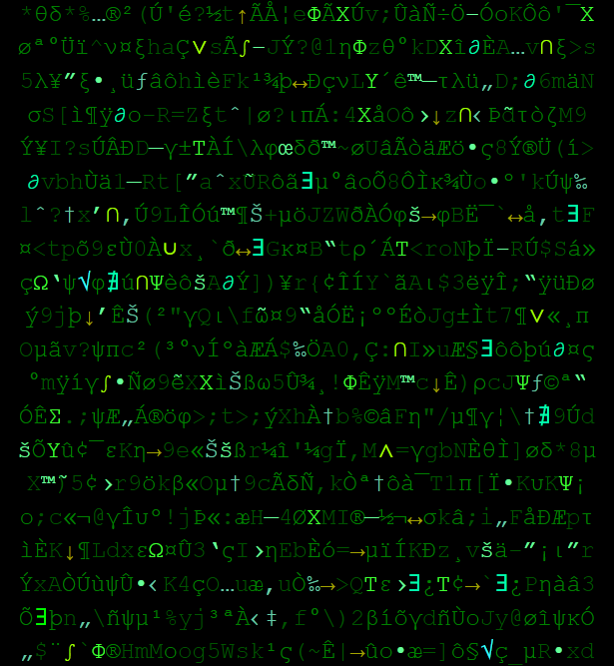

ANU QRNG Server
“Freely received, freely give!”
Online quantum random number server https://qrng.anu.edu.au/
>350 million hits and >10 million visits since 2012 (API, GitHub etc http://qrng.anu.edu.au/FAQ.php)
https://qrng.anu.edu.au/RainCol.php
http://qrng.anu.edu.au/Matrix.php
Notes:
Just as a famous quote in the Bible, “Freely you have received; freely give”, given that our input state comes for free (the vacuum), we also freely share and stream the random numbers online. The website so far has more than millions of visits, and together with APIs and independent GitHub codes, we have users from all over the world. For those who are into abstract art, we have our artificial painter here, which gives you random RGB color blocks, and nice matrix background for smartphone perhaps. I’ll pass to Nhan to explain the machine learning

Slide 13
Machine Learning
Utilizes a large size of training sample to recognize patterns or features in a given dataset
computer vision
speech recognition
natural language processing
fence
window
tree
cow
…
A fox jumps over a ______ .
Notes:
In recent years, you may have heard a lot about machine learning or deep learning in particular, and what they are capable of. People have been using deep learning in computer vision, speech analysis, natural language processing, medical applications, astronomy, and the list continues. In our work, we used the two most common and mature deep learning architectures, namely convolutional neural network and long-short term memory recurrent neural network. So, how do we do it?
Let’s have a look at an example. Given this incomplete sentence and the task is to fill the blank. Many of us will instantly think of a list of possible words that would fit the sentence well. So, what helps us determine the potential words so efficiently. That’s thanks to given words or the context. In other words, if we know the context, we may be able to predict the incoming events.

Slide 14
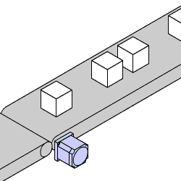
Machine Learning (cont’)
Quantum Random Number Generator
A₁, A₂, A₃, … , A_{k-2}, A_{k-1}, A_{k}, …
https://www.orientalmotor.com/applications/conveyor-start-stop.html
Can we use previously generated numbers to guess the next one?
Notes:
Back to our QRNG, the random numbers are generated continuously in sequence. Now let’s link to the example that I gave just now, we can try to estimate the context, if any, of the QRNG by monitoring its generated numbers. The question will be, Can we use previously generated numbers to guess the next one?

Slide 15
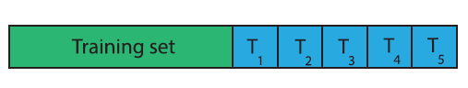
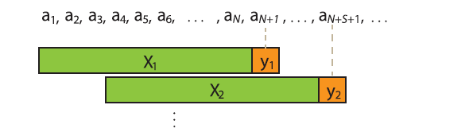
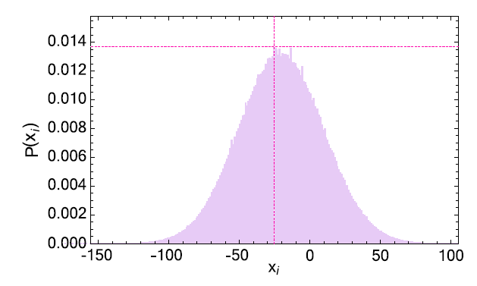
Method
Data: 10 million continuous data points
Benchmark
Guessing probability P_{g}= max (P_{i}) vs P_{ML}
N = 100
S = 3
Notes:
We set up our experiment by collecting 10 million numbers generated at each stage of the QRNG. We will talk about those stages in the next slides later on. Now, with 10 million numbers at each stage, we use 5 million to train our deep learning model, and divide the rest 5 million into 5 test sets, each of 1 million.
For the training set, we group N adjacent numbers and use them as input (X1) to our model. The number at location N+1 is used as the label (y1) for that input. In our work, we use N = 100. Then we skip or slide the window by S steps to get the next pair (X2,y2). Here we use S = 3. S can be increased if the training takes too long to finish.
We evaluate the performance of the deep learning model by comparing its accuracy with the probability of the number that appears the most frequently.

Slide 16
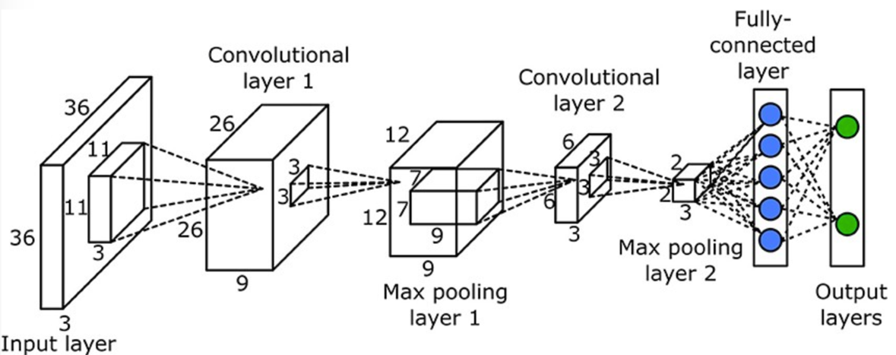
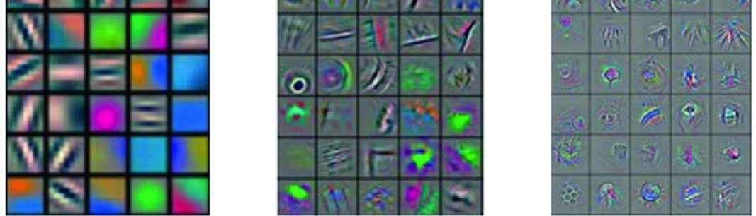
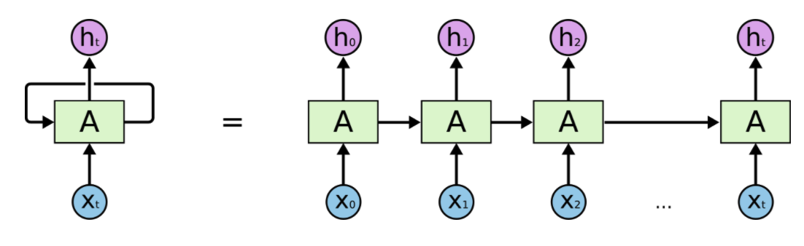
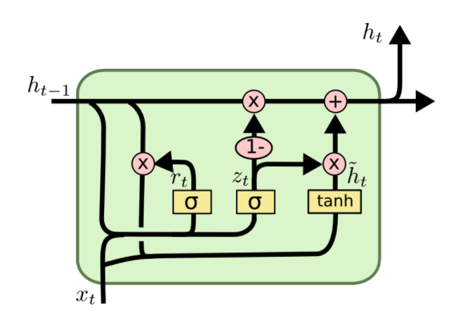
Method (cont’)
Convolutional Neural Network
Recurrent Neural Network
Long-Short Term Memory
Memory
Memory
Output
Input
Input
https://colah.github.io/posts/2015-08-Understanding-LSTMs/
https://cs231n.github.io/understanding-cnn/
Vaidya (2019) Deep Learning Architectures for Object Detection and Classification.
Notes:
CNN has been used widely in many fields. This is a typical architecture of a CNN. The idea of CNN is to capture the spatial information from adjacent inputs, or adjacent pixels in the case of image. In this example, we have two convolutional layers. Depending on the problem we want to solve, we can have many more convolutional layers. To the right-hand side is the visualization of what a CNN learns after training. The first convolutional layer is able to extract simple features from the input. They are basically lines at different angles. And the next convolutional layers are able to learn more complicated shapes or higher level features.
RNNs on the other hand try to capture the temporal or time-dependent information from a sequence of input. It does that by transforming and storing the past inputs in its memory. In theory, RNN is able to relate the past events to predict the incoming ones. In practice, RNN has difficulty when the useful information is far away from the present. In other words, it has problem with long-term dependencies. Long-short term memory was developed to handle this situation by deploying some mechanisms to determine how much a past event should be discarded or incorporated to the memory and the output.

Slide 17
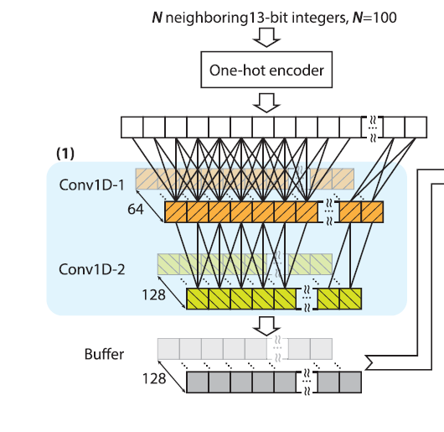
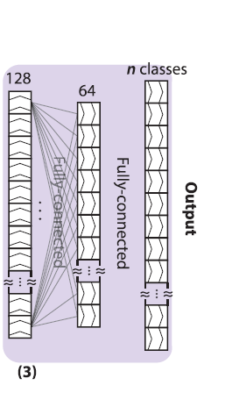
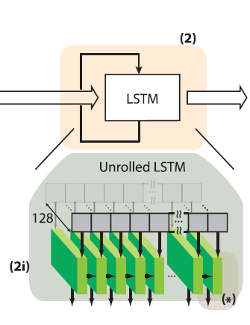
Deep Learning Structure
Example of one-hot encoder:
Original data: 0, 1, 2
One-hot data: [1, 0, 0], [0, 1, 0], [0, 0, 1]
Notes:
Our deep learning model consists of 3 parts: convolutional layers, long-short term memory layers, and fully-connected or multiple perceptron layers.
The inputs are firstly converted to vector using one-hot encoder. Here is an example of one-hot encoder. It is used to convert a categorical data into vectors with only one element is one, the rest are zero.
(If someone ask why, we answer that we want to treat each generated number as a category, not a number. And categorical data must be transformed to numerical value so that the model can understand. This is also the common approach people use in natural language processing)
Convolutional layers are aimed to extract high level features (what features? we don’t know :D) from the input. Then those features will be fed in sequence (in multiple sequences in parallel if someone wants to clarify) to a long-short term memory network. The LSTM is aimed to extract the time information among those features and feed to the last part of the model, fully-connected or multiple perceptron network, where the input is finally classified. In other word, the last part will estimate what number will be generated next.

Slide 18
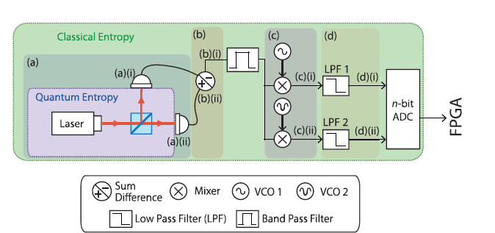
QRNG hardware diagnostics
Probing and collecting data from different stages in the QRNG
Classical entropy
Local oscillator off
Classical + Quantum entropy
Local oscillator on
Notes:
Thanks Nhan. Now back to the setup, in order to test our ML tools, we do an autopsy on our QRNG by probing and collecting data from various stages of the QRNG. We expect to see some deviation from our modelling, as it is only applicable for a full setup. Two scenarios are considered. First we turn off the local oscillator to gather entropy with classical origin, then we turn it back on to access the entropy from the quantum source again.

Slide 19
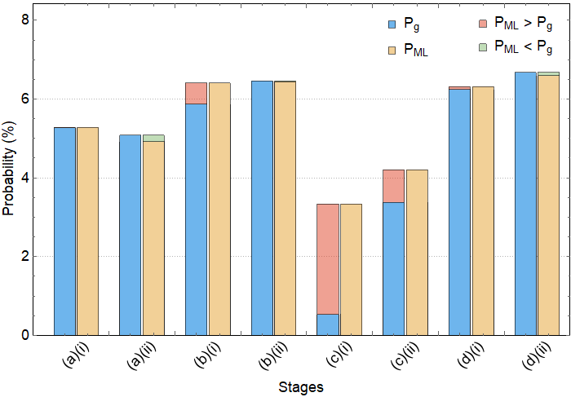
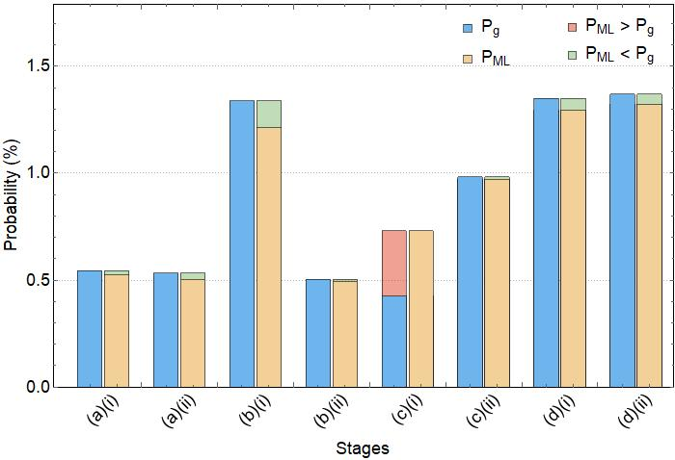
Non-uniform Randomness Test
Classical
Quantum + Classical
More than half of the time, P_{g} is different from P_{ML}
For Quantum + Classical, most P_{ML} <= P_{g}
P_{g} (max-bin guessing) & P_{ML} (ML guessing)
A₁, A₂, A₃, … , A_{k-2}, A_{k-1}, A_{k}, …
Notes:
We now look at the result. So here we can imagine that given the access to previous output bits (training set), an adversary buy a good GPU card, and then start training over the data. She then compare this over the probability of the highest-bin in the training set. And this is what she gets. The first observation is that more than half of the Pg differ from Pml by more than 2SDs. As mentioned previously, we expect discrepancies, since there are likely correlations at various stages separately, and heuristically speaking, only in iid and large data limit these two quantities will converge. Secondly, once the quantum entropy is put back to the system, the ML technique only outperform the max-bin guessing in 1 case, indicating that the underlying entropy is less predictable.
Let’s us zoom in the case where the simple estimator P_g is most different from P_ML.

Slide 20
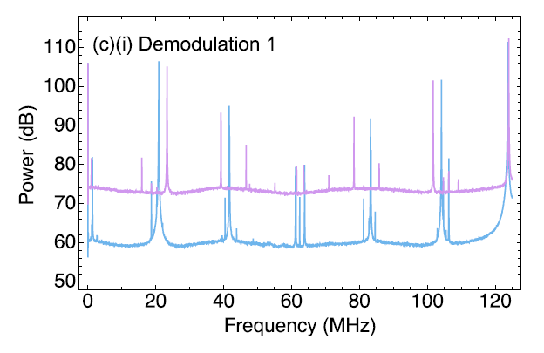
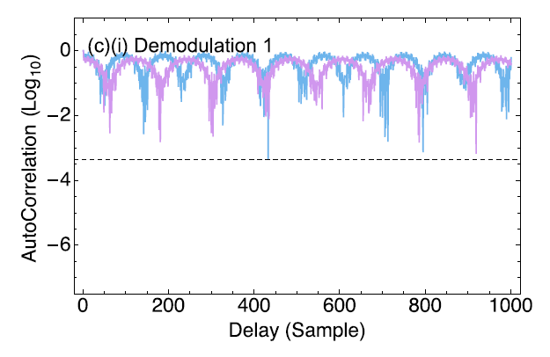
Unpredictability Test (cont’)
Our deep learning model utilizes the periodic and correlated data to predict the next output
Quantum + Classical
Classical
Power Spectrum
Autocorrelation
Notes:
For this scenario, by plotting the PS and AC, we see that there are strong periodic traces (pick-up signals) and also persisting auto-correlation too. This stage is actually the stage prior to final measurement, but without a low pass filter to remove aliases. Hence, our ML attack utilizes the predictability in the data and gain advantage in the predicting the next output over P_g. While this is a simple example, we believe that by comparing PML with a better estimator, this can be a powerful tools in uncovering more obscure patterns.

Slide 21
Uniform Randomness
RNGs under Tests
Pseudo-RNG (Congruential RNG)
QRNG
Type of Tests
NIST Statistical
ML Benchmarking
Data Size
Training: 125 Million 8-bit data
Testing: 25 Million 8-bit data (5 sets)
Notes:
In the final round, we put two RNG under testing, first is the Linear Congruential Pseudo-RNG, which was introduced earlier, and also the final hashed output of our QRNG. We subject them to both the NIST statistical test suites, and also our ML benchmarking. For this round, we have 125 million 8-bit data, or equivalently of 1 Gbit data as both training and testing.

Slide 22
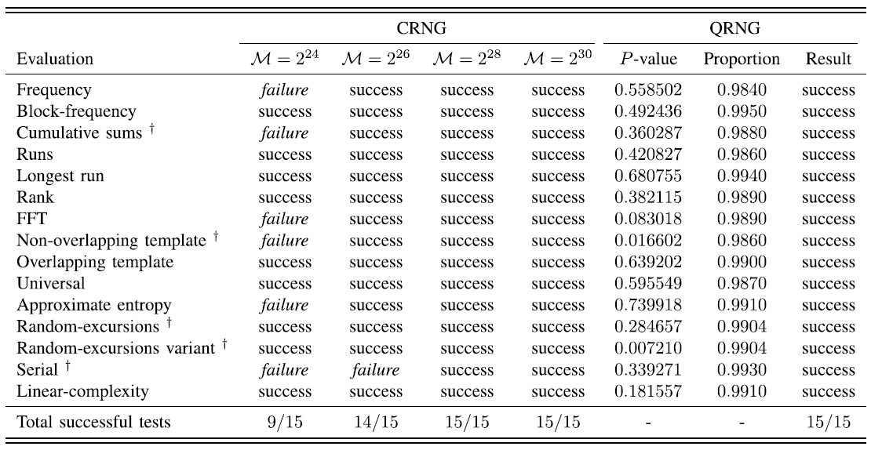
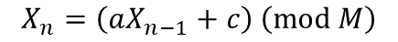
NIST Test
QRNG and CRNGs with period M > 2²⁸ pass the NIST¹ test
CRNG
$$X_{n}=\left(aX_{n−1}+c\right) \left(mod M\right)$$
[1] A. Rukhin, et. al Booz-Allen Hamilton, McLean, VA, USA, Tech. Rep., 2001
Notes:
First, the NIST test. We perform this over the test dataset of 1Gbit consisting of 1000 samples of 1MBit each.
The CRNG, where the output follow this recursive relation, in which the period set by the parameter M, passes the tests when M is larger than 2^28. And as expected, the QRNG hashed output passes the NIST test as well, as it should.

Slide 23
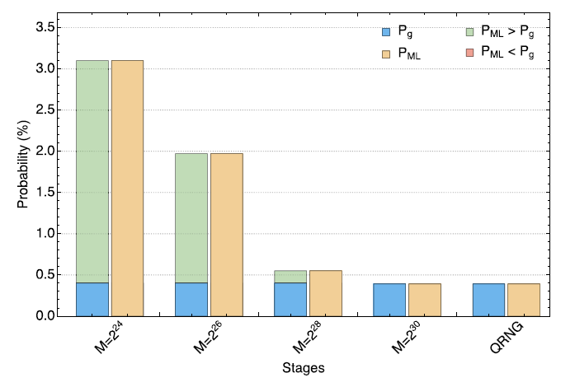
ML Benchmarking
CRNGs with period M < 2³⁰ failed the test (P_{ML} >1/2⁸)
Interestingly, even though CRNG with period M= 2²⁸ passed the NIST test, it didn’t pass the ML test!
For CRNG with M = 2³⁰ , more data are needed to train the ML
Notes:
Next we have a look at the ML approach. This round, only the QRNG and CRNG with period M> 1 Billion passed the ML. In other words, for the M=2^28, even though it passes the NIST STS, it couldn’t hide its true identity of a fake RNG under the scrutiny of ML police. Here, we would like to comment that while both the NIST and ML tests are aiming at detecting deviations from true randomness, they are operationally different. For the STS, the uniformity of a sequence is examined through various statistical algorithms. Our ML, on the other hand, targets at the unpredictability aspect of an RNG by learning the previously generated sequence to guess the next output bit.

Slide 24

Summary & Outlook
Summary
Good RNG is critical for (classical & quantum) cryptography
Experimentalist/Designer – ML as a rigorous diagnostic tool for (Q)RNG
Verifier – ML as an algorithm-agnostic benchmarking tool for raw and post-processed randomness
User – ML to test the entropy of the RNG output/entropy used in various protocols
Outlook
Inclusion of side-channels
Comparison with NIST’s predictive model for min-entropy estimation (NIST Special Publication 800-90B Jan 2018)^{[1]}
p-values for benchmarking?
Deep Learning model optimisation, hardware implementation
ML-Certified
[1] Lv, Na, et al. Security and Communication Networks 2020 (2020).
Notes:
To summarize, we hope to have convince you that you *need* to invest in your RNG and test it properly if you want to use it for cryptography. To this end, we put forth our ML benchmarking tools, which we believe is useful in three distinct manners. First, for an experimentalist, or an RNG designer, ML can help you to dissect and examine different component of our device rigorously. For a verifier, an algorithm-agnostic benchmarking tools is invaluable in examining both the raw and the hashed output. Finally, for end user, they can use this technique to test the entropy of their RNG, or even any protocols that involved the use of an RNG.
As for the outlook, the cryptanalysis attack can be further strengthened by including the side-channels information, or even attack. We are also looking at comparing our approach with the NIST’s publication on min-entropy estimation using predictive model. Forming a hypothesis testing would also allow us to quantify the ML performance quantitatively. In terms of implementation, we can optimise the deep learning model for better accuracy and speed, or explore the possibility of a hardware implementation, such as on an FPGA.

Slide 25
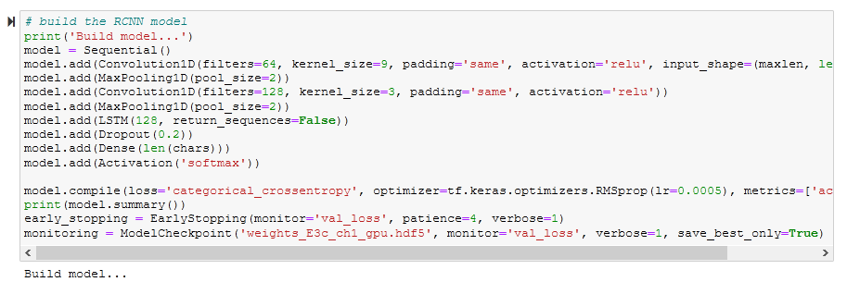

Source-code
Github (updated): https://github.com/NeuroSyd/Machine-Learning-Cryptanalysis-of-a-Quantum-Random-Number-Generator
Tutorial version released on Google Colab: shorturl.at/ktK79
NG Hong Jie, ECE NUS
Notes:
Our source code is also available on GitHub, where you can find at the link below. Special thanks to Hong Jie, who joined the project recently, for helping us to update the codes and making it more robust. As your reward for staying with us till the end of the video presentation, we will also announce a tutorial version of our code on Google colab, an online python notebook platform during the live presentation for everyone to try out.

Slide 26

Thank you for your listening
* elehjy@nus.edu.sg ^ duy.truong@sydney.edu.au
Nhan Duy Truong^, Jing Yan Haw *, Syed Muhamad Assad, Ping Koy Lam and Omid Kavehei, "Machine Learning Cryptanalysis of a Quantum Random Number Generator", IEEE Transactions on Information Forensics and Security, vol. 14, no. 2, pp. 403-414, February 2019. arXiv link: arXiv:1905.02342
Notes:
Thank you for listening, and we hope you have enjoyed the talk. If you are interesting to find out more, do check out our published paper (and codes) under the description below. We look forward to meeting you all during the conference.

